Slide 1
Contents
Glossary or Formula Page
Page
Date
Description
2
3

Slide 2
Tasks
24
7
30
Essential Question
Questions
Notes
Summary
4
5

Slide 3
24
7
30
Date
Fractions and Percentages
EQ – What are the relationships between fractions and percentages
Convert Percents to Fractions
To convert a Percent to a Fraction follow these steps:
Step 1: Write down the percent divided by 100.
Step 2: If the percent is not a whole number, then multiply both top and bottom by 10 for every number after the decimal point. (For example, if there is one number after the decimal, then use 10, if there are two then use 100, etc.)
Step 3: Simplify (or reduce) the fraction
5

Slide 4
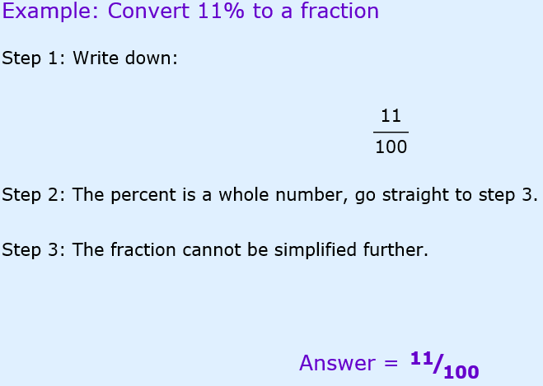
24
7
30
Date
Fractions and Percentages
EQ – What are the relationships between fractions and percentages
Example: Convert 11% to a fraction
5

Slide 5
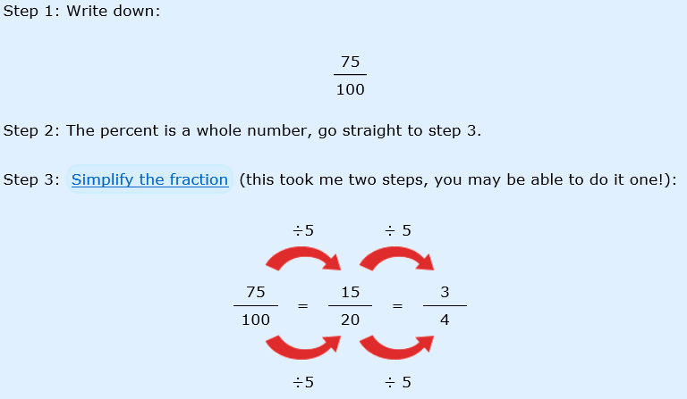

24
7
30
Date
Fractions and Percentages
EQ – What are the relationships between fractions and percentages
Example: Convert 75% to a fraction
5

Slide 6
Complete Exercise 1.4, questions 1 to 20 on page 5, Dwyer textbook

Slide 7
24
7
30
Date
Fractions and Percentages
EQ – What are the relationships between fractions and percentages
Convert Fractions to Percents
Divide the top of the fraction by the bottom, multiply by 100 and add a "%" sign.
5

Slide 8
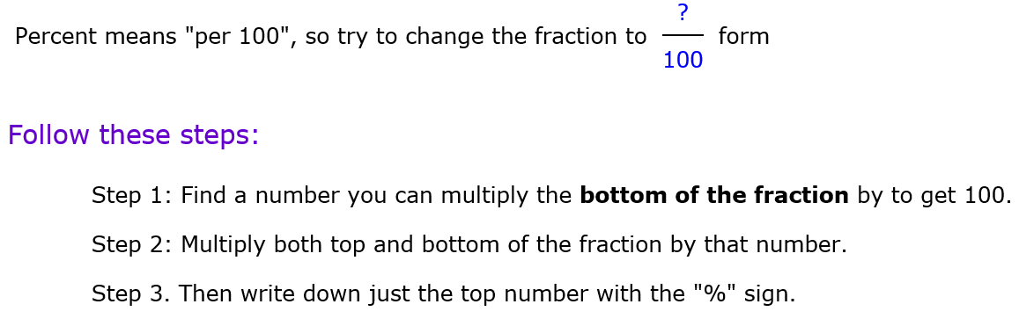
24
7
30
Date
Fractions and Percentages
EQ – What are the relationships between fractions and percentages
5

Slide 9
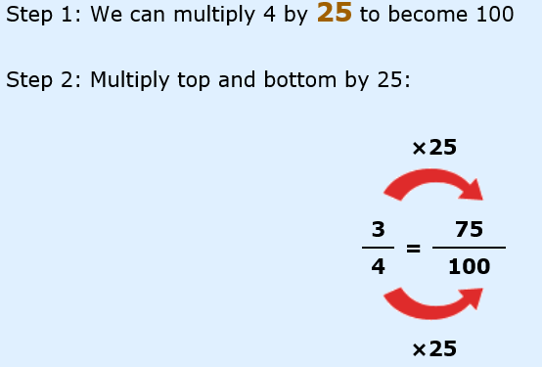
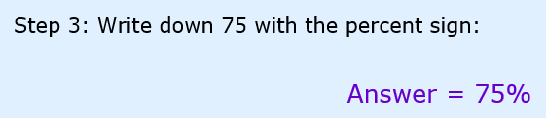
24
7
30
Date
Fractions and Percentages
EQ – What are the relationships between fractions and percentages
Example 1: Convert ³/₄ to a Percent
5

Slide 10
Complete Exercise 1.4, questions 1 to 20 on page 5, Dwyer textbook

Slide 11
24
7
30
Date
Fractions and Percentages
EQ – What are the relationships between fractions and percentages
Finding a Percentage of a Quantity
To find a certain percentage of a given quantity, write the percentage as a fraction out of 100 and change the 'of' to a ×. Then simplify.
5

Slide 12
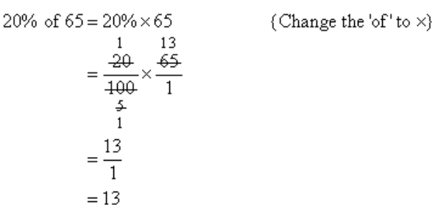
24
7
30
Date
Fractions and Percentages
EQ – What are the relationships between fractions and percentages
Example: Find 20% of 65
5

Slide 13
Complete Exercise 1.5, questions 1 to 24 on page 6, Dwyer textbook

Slide 14
Questions

Slide 15
Notes Review
24, 7 ,30
Date
Title
Essential question
Notes complete
Notes complete with colour and diagrams
Questions completed
Contents page filed in
Formula page filled in

Slide 16
Homework
Review your notes and write a summary answering the essential question.

